Slide 1
PATHFINDER LEADERSHIP AWARD SESSION NO.3
Risk Assessment

Slide 2
Presentation Structure:
What is Risk
Why doing Risk Assessment?
When to do Risk Assessment?
Who does Risk Assessment?
Where to do Risk Assessment?
How to perform Risk Assessment?
Activity
Project/Homework

Slide 3
ICE BREAKER

Slide 4
What is Risk?
Hazard
Anything that has the potential to cause harm or danger to someone or something.
E.g., Knife, Weather, Electricity, Noise, Fire, Heights, Dust, Fast Flowing River, etc…
2. Risk
The chance of the hazard escalating to an injury or accident.
E.g., Prolong exposure to heat causing sun burn
RISK= LIKELIHOOD X CONSEQUENCE

Slide 5
Why doing Risk Assessment?
Know the hazards and associated risks
Quantify risk according to severity and likelihood ( Risk Matrix)
Put Preventative and Mitigative Control Measures to prevent risk or to minimize the impact should incident occur.
Note: Control measures doesn’t STOP the impacts. It reduces the chances of the risk event from occurring.
Likelihood= Influenceable
Consequence/Impact= Fixed

Slide 6
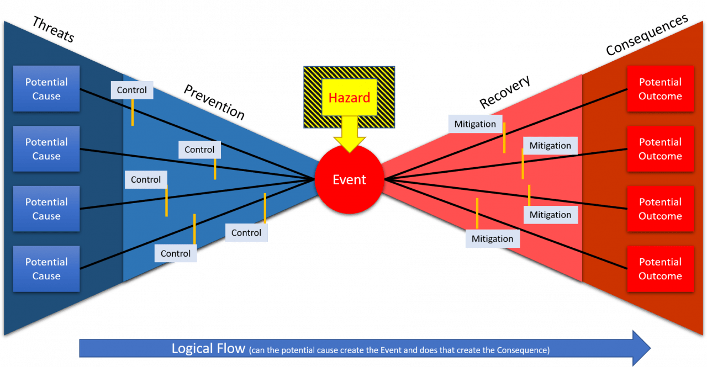
Why doing Risk Assessment?
Visualize the risk through Bowtie diagram:
L.H.S
R.H.S
L.H.S
Notes:
The bow tie method is a visual way of understanding the impacts of a hazard, the risk it presents, the consequences and the controls that should be put in place

Slide 7
When to do Risk Assessment
Generally, in every situation you could do risk assessment. You could do a simple risk assessment to a full-blown risk assessment.
Putting to the context of AYM ministry, below are some fitting events you would want to carry out risk assessment:
Outdoor Camping
Drill & Marching
Camporee Events ( E.g., 2023 PNGUM Pathfinder Camporee)
District Activities ( E.g., District Camping)

Slide 8
Who does Risk Assessment?
Risk Assessment Team should consist of:
Facilitator – chairperson ( both gender)
Senior Staff member
Director/Instructor/Coordinator
Church Rep ( Optional)
Senior Pathfinder
NOT A ONE-MAN GAME!
Notes:
Team or group of experienced people.
Experience in the context of;
Risk
Hazard
Control Measures – Bowtie diagram
NOT BY AN INDIVIDUAL PERSON!

Slide 9
Where to do Risk Assessment?
Workshop-based session for high-risk activity
Flexibly open to suggestion depending on the nature of the risk.
Having the right people in a conducive environment is the key.
PREVENTION IS BETTER THAN CURE
Notes:
Team or group of experienced people.
Experience in the context of;
Risk
Hazard
Control Measures – Bowtie diagram
NOT BY AN INDIVIDUAL PERSON!

Slide 10
How to perform risk assessment?
Tools to perform risk assessment:
1. Bowtie Diagram – visualizing risks, impacts, and control measures.
MITIGATIVE MEASURES
PREVENTATIVE MEASURES
Notes:
The bow tie method is a visual way of understanding the impacts of a hazard, the risk it presents, the consequences and the controls that should be put in place

Slide 11
How to perform Risk Assessment?
2. Risk Matrix– determine severity of risk, and associated impacts.
CONSEQUENCE/IMPACTS |  |  |  | Severity | LIKELIHOOD
 |  |  |  |  | Frequent | Likely | Possible | Unlikely | Rare
Financial | Safety | Reputation | Environment |  | once per quarter) | Once per year | Once every 5 to 10 years | Once every 10 to 50 years | Once every 100 years
>K100,000 | Multiple fatalities | SPD | Wide spread irreparable damage | Critical | C | C | H | H | M
K50,000 to K100,000 | Single fatalities | PNGUM | Wider spread long to medium term damage | Major | C | H | H | M | M
K10,000 to K50,000 | Hospitalisation | CPC | Localised medium term damage | Serious | H | H | M | M | L
K5,000 to K10,000 | First Aid | District | Localised short term to medium term | Moderate | H | M | M | L | L
<K5,000 | Negligible | Local Club | Limited damage to a localised area | Minor | M | M | L | L | L

Slide 12
Activity #1: Bowtie application
Develop a bowtie for swimming honor activity. List down the hazard, the risk event, preventative controls, and the mitigative measures. Complete the bowtie.

Slide 13
Activity #2: Risk Matrix
Perform risk assessment using risk matrix for the above exercise. Determine severity of risk, and associated consequences.

Slide 14
Homework
Develop Risk Matrix for MNE District
Develop Bowties for Major Accident Event (M.A.E)
Develop Risk Assessment Form for MNE District
Notes:
The bow tie method is a visual way of understanding the impacts of a hazard, the risk it presents, the consequences and the controls that should be put in place

